Slide 1
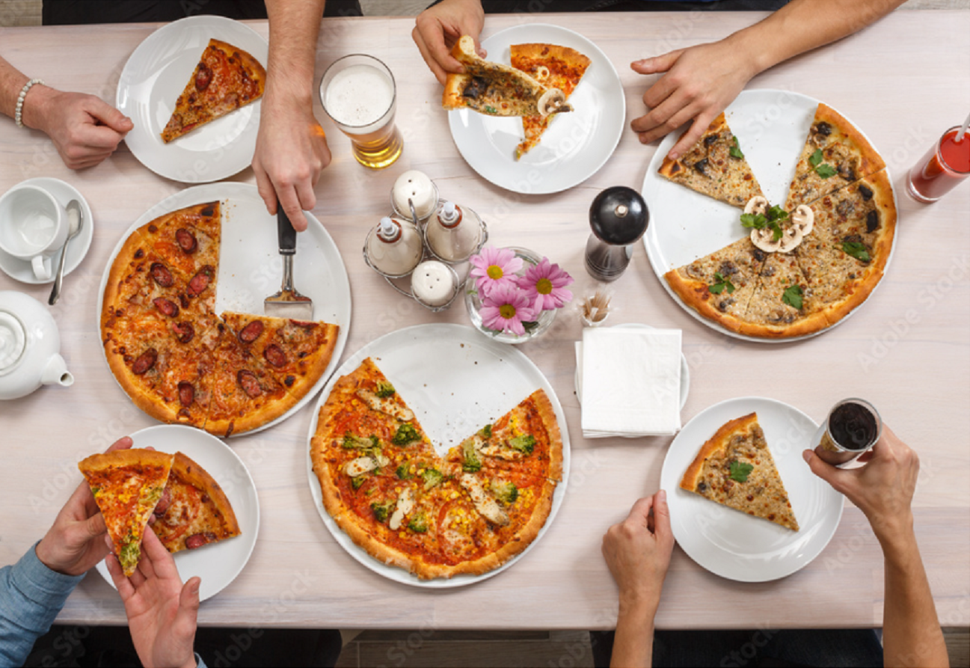
WELCOME TO MYSQL PRESENTATION WITH PIZZA SALES DATA

Slide 2
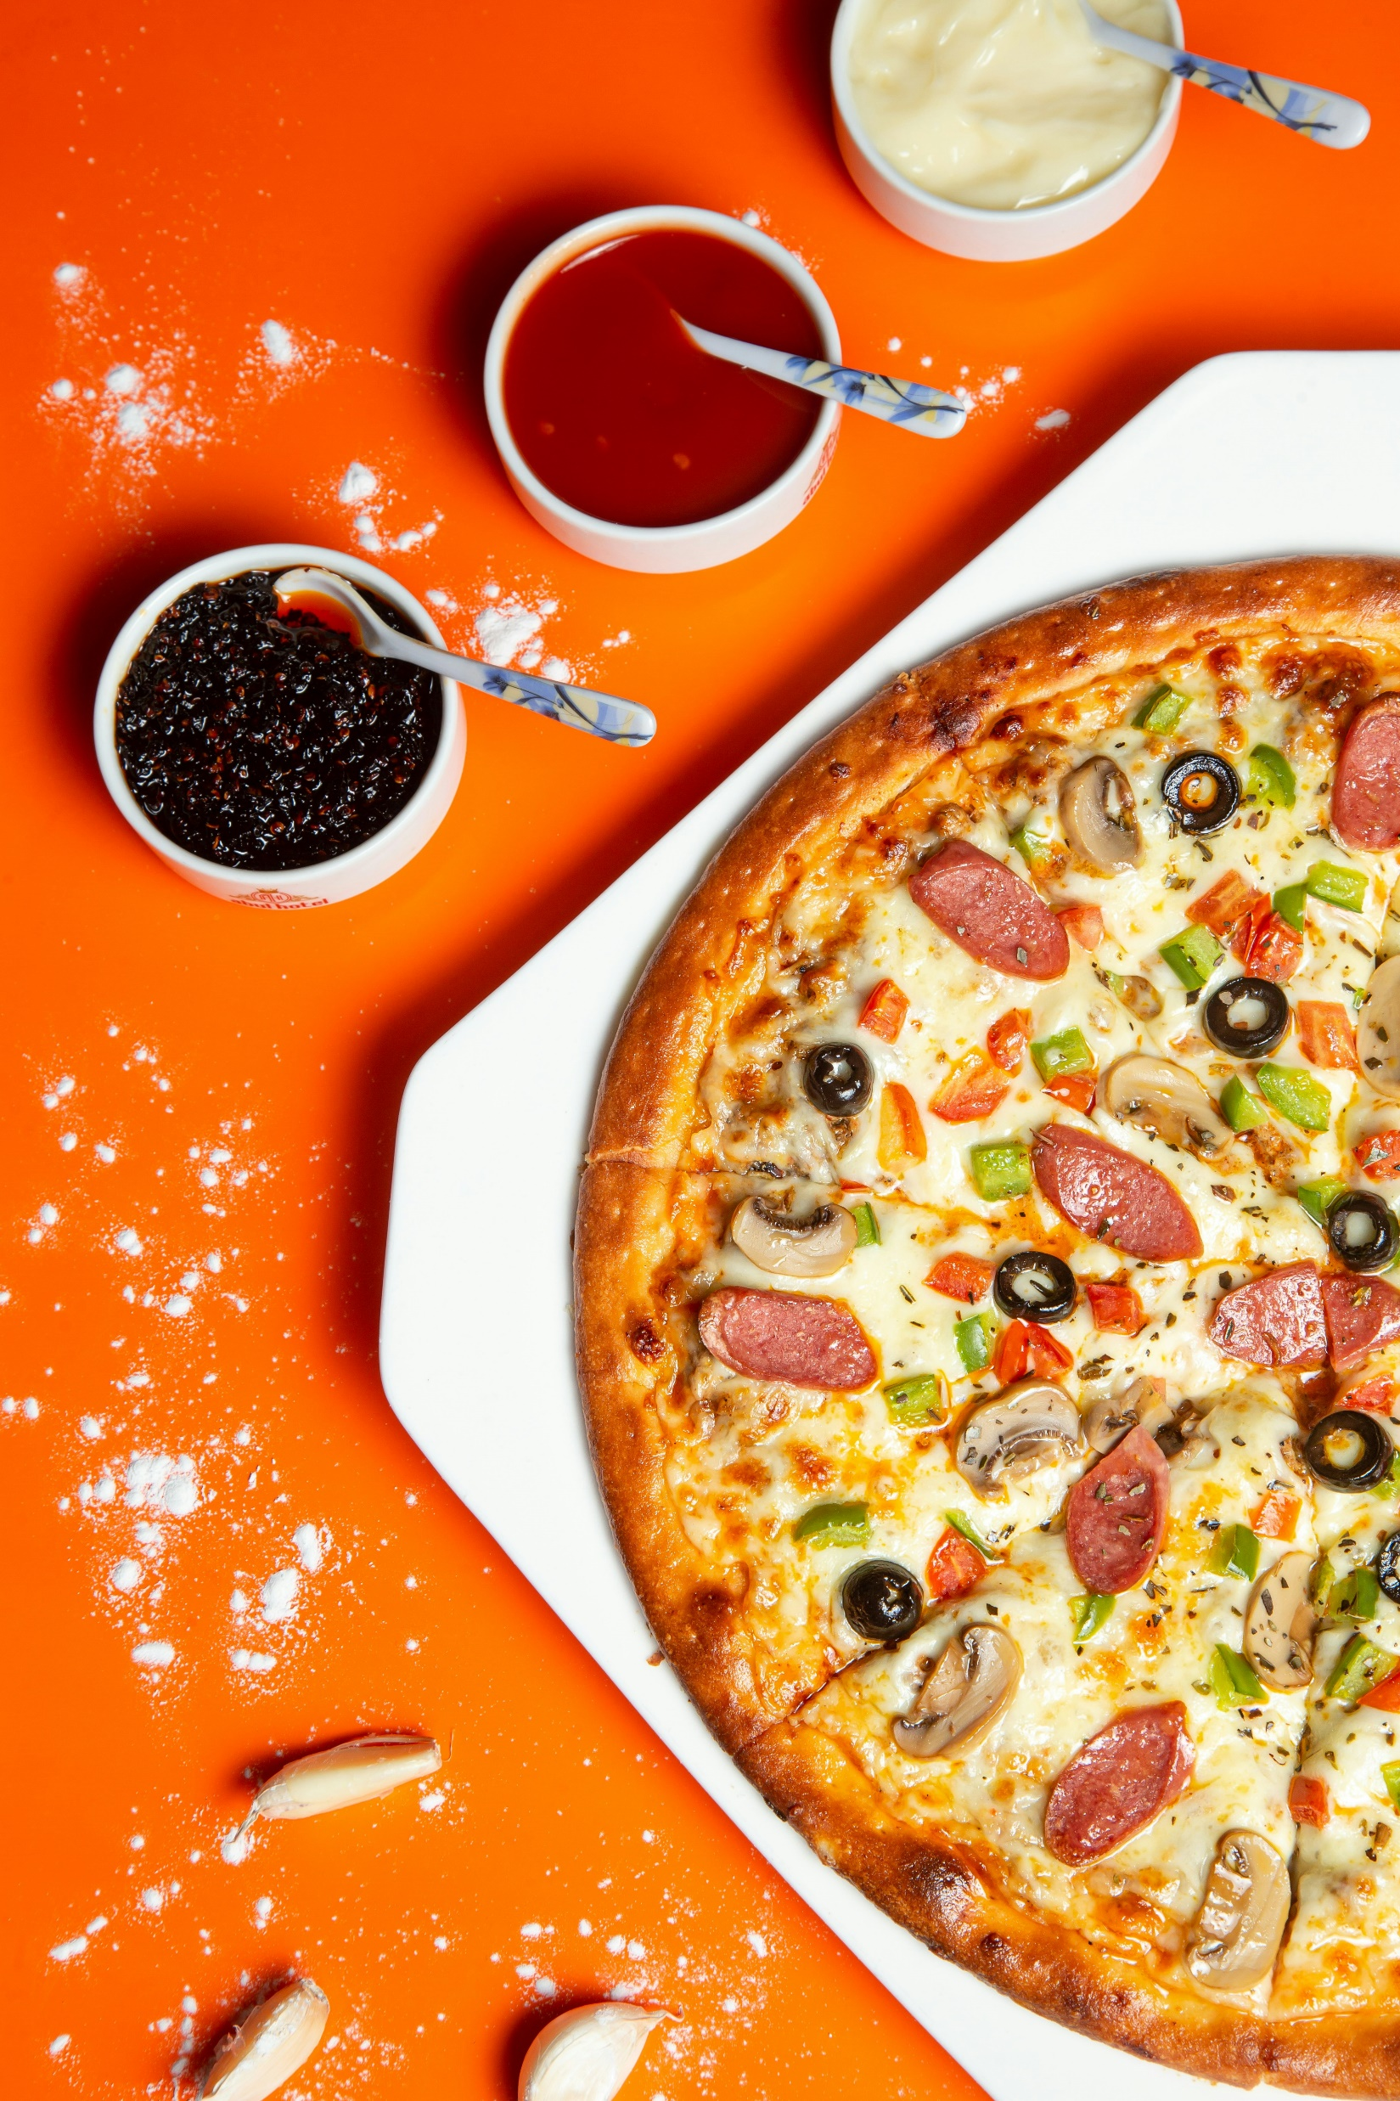
Table of Contents
Introduction
Problem Statement
objective
Functionality
MySQL Quary
Conclusion

Slide 3

Introduction
Hello,
I am excited to introduce the Sales Pizza Project — a strategic initiative focused on elevating pizza sales through smart data and technology. Our goal is simple: enhance sales, delight customers, and streamline operations within the pizza industry.
Key Highlights:
Data-Driven Sales: Boost revenue with insights-driven sales strategies .
Customer Delight: Personalize experiences and promotions for happy customers.
Efficiency Matters: Streamline operations for smoother and cost-effective processes.
Tech Integration: Embrace modern solutions for seamless order management.
The Sales Pizza Project isn't just about pizza; it's about shaping the future of sales in the food industry. Dive in, explore our approach, and see the positive impact we're poised to make.
Thanks for your interest in the Sales Pizza Project!

Slide 4

Problem statement
The current trend of declining pizza sales within our company signals a pressing challenge that demands immediate attention. Despite having a strong reputation for quality and taste, our pizza products are experiencing a consistent decrease in sales, leading to concerns about our market competitiveness and overall revenue. Understanding the reasons behind this decline is essential for devising targeted strategies to reinvigorate pizza sales, retain customer loyalty, and regain a prominent position in the market. Therefore, it is imperative to conduct a comprehensive analysis of the factors contributing to the decline in pizza sales and develop a robust action plan to reverse this trend and ensure sustained growth in our pizza product line.

Slide 5

Objective
The overarching goal is to reverse the current trend of declining pizza sales and propel the brand towards sustainable growth. By implementing a comprehensive strategy, the objective is to boost pizza sales by a specific percentage, ensuring measurable and tangible results within a predetermined timeframe.
This entails a multifaceted approach, encompassing product innovation to cater to evolving consumer preferences, targeted marketing campaigns to interest and attract new customers, and a commitment to enhancing the overall quality of the pizza offerings.
Through the pursuit of these objectives, the aim is to not only drive short-term revenue gains but also to fortify the brand's image, making it synonymous with quality, innovation, and customer-centricity. Regular evaluation and adaptation of strategies will be crucial to ensure sustained success

Slide 6

Functionality
I have used different types of functions and clause solve this problem on MySQL to
help me Find the trend of data , summarize of sales and market analysis.
Aggregate function -: Sum , count ,avg ,max to find total sales , number of quantity
pizza sales , avg. of sales per order and maximum sales
Date function -: Day name , Month name , Year , Hour with help of date function
I found trend of Sales.
Different Clause :-
A) Group by :- It used to group rows that have the same values in specified columns
into summary rows, like "total sales per category”
B) Order by :- It used to group rows that have the same values in specified
columns into summary rows, like "total sales per category“
C) Limit :- It used restrict the number of rows returned by a query.

Slide 7
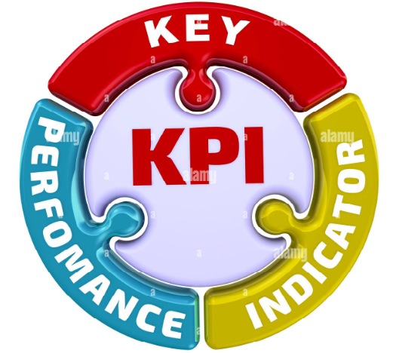

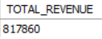
MySQL Quary
Key Performance Indicator (KPI) is a way to measure how well something is doing. It's like a score or a number that tells you if you're reaching your goals or doing a good job. KPIs help you track and understand performance in a straightforward and measurable way.

Slide 8

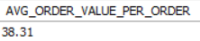

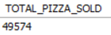

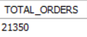

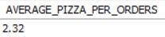

Slide 9
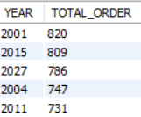
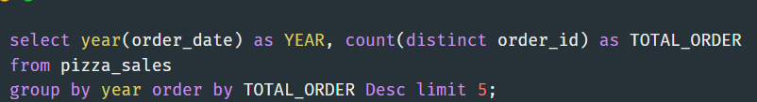
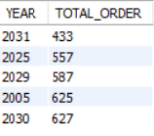
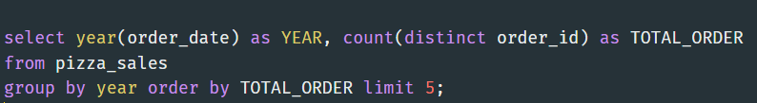
Trends and percentage of sales
Top 5 year by total Orders
Bottom 5 year by total Orders

Slide 10
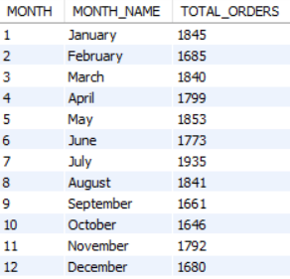
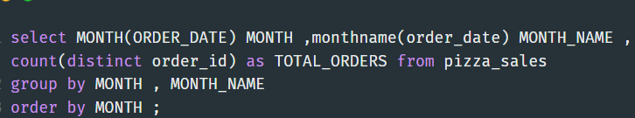
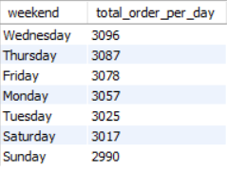
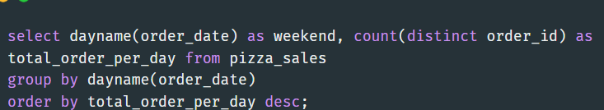
Monthly Trend for total Orders
Daily Trend for total Orders

Slide 11
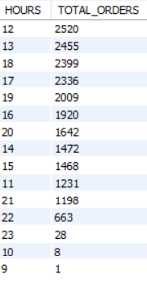
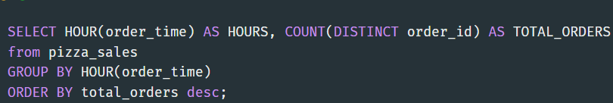
Hourly Trend for total Orders

Slide 12
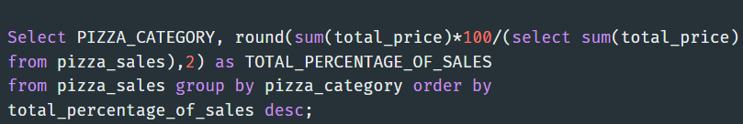
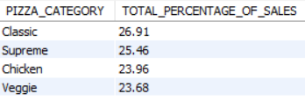
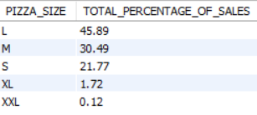
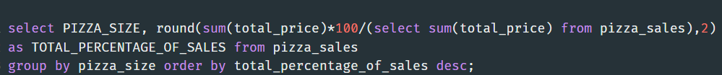
Percentage of Sales by Pizza Category
Percentage of Sales by Pizza Size

Slide 13
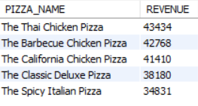
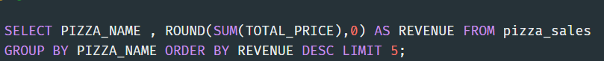
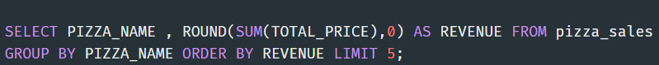
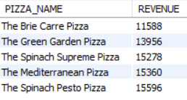
Top 5 pizza by Revenue
Bottom 5 pizza by Revenue

Slide 14
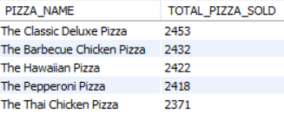
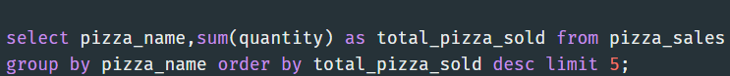
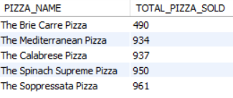
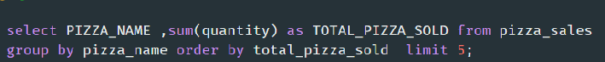
Top 5 pizza by Total Pizza Sold
Top 5 pizza by Total Pizza Sold

Slide 15
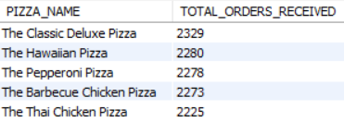
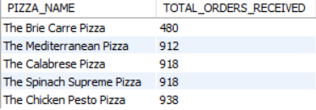
Top 5 Pizza By Total Order Received
Bottom 5 Pizza By Total Order Received

Slide 16

Conclusion
YEAR
Orders are highest year on 2001 and 2015.
MONTH
Orders are max. received on MAY & JULY MONTH.
DAY
Almost all days are comparatively Same according Sales
while weekend on Wednesday & Thursday maximum sales
and Time 12 to 7 pm are very busy timing.
PIZZA CATEGORY
Highest pizza sold and orders by CLASSIC CATE. 27%.
PIZZA SIZE
Highest pizza sales according to size LARGE 46%.
REVENUE
The Thei Chicken pizza contributed max. revenue. 43434
QUANTITY & TOTAL ORDERS
The Classic Deluxe Pizza cont. to max. total quantity 2453
and max. total Orders 2329.
INSIGHT

Slide 17
Yearly Balance :-
Implement targeted promotions in non-peak years to boost sales.
Analyze and address factors contributing to lower sales in certain years.
Monthly and Daily Strategies :-
Extend promotions to months beyond May and July.
Identify and promote specials on traditionally slower days.
Timing Optimization :-
Target secondary busy periods with promotions.
Ensure adequate staffing during all peak times.
Product Diversification:
Introduce new items to diversify offerings.
Balance sales across different pizza categories.
Customer Retention:
Offer loyalty programs for repeat business.
Provide exclusive deals during non-peak periods.
ACTION

Slide 18
Continuous Improvement:
Regularly review sales data for adjustments.
Adapt menu and operations based on customer feedback.
Market Research:
Stay informed about changing customer preferences.
Adapt offerings to meet evolving trends.
Infrastructure Investment:
Ensure scalable infrastructure for demand fluctuations.
Invest in technology for streamlined operations.
Pizza Category and Size Optimization:
Promote Classic category to maintain sales.
Highlight other pizza sizes to balance sales.
Introduce promotions for pizzas contributing less to revenue.
Quantity and Total Orders:
Promote Classic Deluxe Pizza for continued high quantity and orders.
Analyze and enhance promotions for other pizzas to increase sales
ACTION

Slide 19


